Slide 1
Raspberry pi: Webserver (Apache, HTML, PHP)
Day - 5

Slide 2
Installing Apache2 webserver and php
$ sudo apt-get update
$ sudo apt-get install apache2 –y
Enter the ip into the browser
cd /var/www/html/
sudo chown pi: index.html (change the user)
sudo apt-get install php5 libapache2-mod-php5 –y
or
sudo aptitude install php5 libapache2-mod-php5 -y
If any package is not installing due dependency error we use
$ sudo aptitude install [package name]

Slide 3
Mysql:
$ sudo apt-get install mysql-server php5-mysql –y
This will ask you to enter the root password password : raspberry
$ mysql –u root –p [to run the mysql server]
Password : raspberry
mysql> create database wordpress;
mysql> GRANT ALL PRIVILEGES ON wordpress.* TO ‘serverdemo' IDENTIFIED BY ‘demopi’;
mysql> FLUSH PRIVILEGES; #[ to establish the privileges]
mysql> exit;

Slide 4
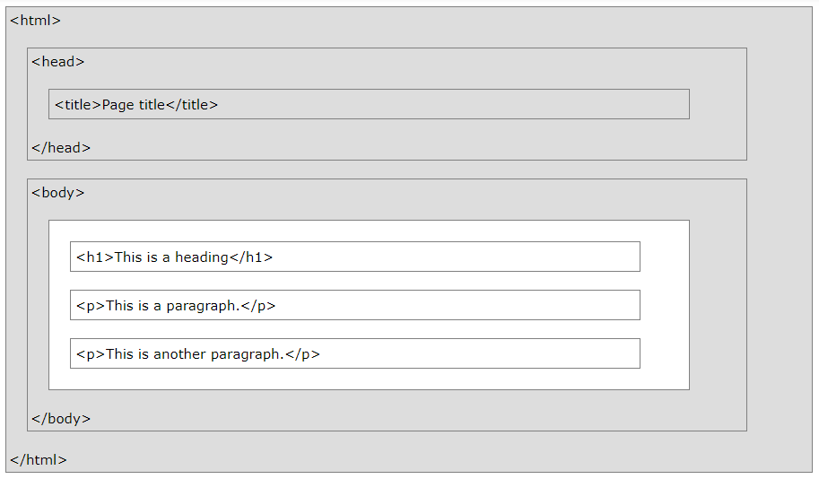
HTML:
<tagname>
content goes here...
</tagname>
Surrounded by Ankel bracket and end tag starts with a forward slash

Slide 5
HTML :
$ cd /var/www/
$ sudo nano index.html
<!DOCTYPE html>
<html>
<body>
<h1>Welcome to Workshop on Raspberry PI.</h1>
<p> We will learn:<br>
Setting up webserver on raspberry pi.
Basics on: HTML and PHP
</p>
</body>
</html>

Slide 6
HTML : Hyper Text Markup Language
The <!DOCTYPE html> declaration defines this document to be HTML5
The <html> element is the root element of an HTML page
The <head> element contains meta information about the document
The <title> element specifies a title for the document
The <body> element contains the visible page content
The <h1> element defines a large heading
The <p> element defines a paragraph

Slide 7
HTML
Links:
<a href="https://www.w3schools.com/htmL/">This is html online tutorial link:</a>
Images:
<img src=“img_name.jpg" width="104" height="142">
Button:
<button>Click me</button>
Style:
<tagname style="property:value;">
e.g.: <body style="background-color:powderblue;">
e.g.: <p style="color:red;">This is a paragraph.</p>
e.g.: <p style="font-family:courier; background-color:powderblue;">This is a paragraph.</p>
Comments:
<!-- Write your comments here -->
Border:
<h1 style="border: 2px solid Tomato;">Hello World</h1>

Slide 8
HTML: CSS (Cascading Style Sheets)
<!DOCTYPE html>
<html>
<head>
<style>
h1 { color: blue; font-family: verdana; font-size: 300%; }
p { color: red; font-family: courier; font-size: 160%; }
</style>
</head>
<body>
<h1>This is a heading</h1>
<p>This is a paragraph.</p>
</body>
</html>

Slide 9
HTML : CSS
<!DOCTYPE html>
<html>
<head><style>
.button { background-color: #4CAF50;
border: none;
color: white;
padding: 15px 32px;
text-align: center;
text-decoration: none;
display: inline-block;
font-size: 16px;
margin: 4px 2px;
cursor: pointer;
border-radius: 10px; }
</style></head>
<body>
<h2>CSS Buttons</h2>
<button>Default Button</button>
<a href="#" class="button">Link Button</a>
<button class="button">Button</button>
<input type="button" class="button" value="Input Button">
</body>
</html>

Slide 10
HTML: table
<table style="width:100%"> <tr> <th> Firstname </th> <th> Lastname </th> <th> Age </th> </tr> <tr> <td> Jill </td> <td> Smith </td> <td> 50 </td> </tr> <tr> <td> Eve </td> <td> Jackson </td> <td> 94 </td> </tr> </table>

Slide 11
PHP
$ sudo nano index.php
<?php echo “PHP: hello world!”; ?>
Run the IP into the browser
<?php echo date(‘Y-m-d H:i:s’); ?> //date and time

Slide 12
PHP :
Server scripting language: PHP scripts are executed on the server.
Acronym: Hypertext Preprocessor.
PHP files can contain text, HTML, CSS, JavaScript, and PHP code
PHP code are executed on the server, and the result is returned to the browser as plain HTML
PHP files have extension ".php"

Slide 13
PHP:
<!DOCTYPE html> <html> <body> <h1>My first PHP page</h1> <?php echo "Hello World!"; ?> </body> </html>

Slide 14
PHP: Variables
<!DOCTYPE html> <html> <body> <?php $txt = "Hello world!"; $x = 5; $y = 10.5; echo $txt; echo "<br>"; echo $x; echo "<br>"; echo $y; print "<h2>PHP is Fun!</h2>"; print $x + $y; ?> </body> </html>

Slide 15
PHP: Array
<!DOCTYPE html> <html> <body> <?php $cars = array("Volvo","BMW","Toyota"); var_dump($cars); ?> </body> </html>

Slide 16
PHP: Class
<!DOCTYPE html> <html> <body> <?php class Car { function Car() { $this->model = "VW"; } } // create an object $herbie = new Car(); // show object properties echo $herbie->model; ?> </body> </html>

Slide 17
PHP: String
<!DOCTYPE html> <html> <body> <?php echo strlen("Hello world!"); echo str_word_count("Hello world!"); echo strrev("Hello world!"); echo strpos("Hello world!", "world"); echo str_replace("world", "Dolly", "Hello world!"); ?> </body> </html>

Slide 18
PHP: String Concatenation
<!DOCTYPE html> <html> <body> <?php $txt1 = "Hello"; $txt2 = " world!"; $txt1 .= $txt2; echo $txt1; ?> </body> </html>

Slide 19
PHP : if else
<?php $t = date("H"); if ($t < "20") { echo "Have a good day!"; } ?>

Slide 20
PHP: switch case
<?php $favcolor = "red"; switch ($favcolor) { case "red": echo "Your favorite color is red!"; break; case "blue": echo "Your favorite color is blue!"; break; case "green": echo "Your favorite color is green!"; break; default: echo "Your favorite color is neither red, blue, nor green!"; } ?>

Slide 21
PHP: while
<?php $x = 1; while($x <= 5) { echo "The number is: $x <br>"; $x++; } ?>

Slide 22
PHP: for loop
<?php for ($x = 0; $x <= 10; $x++) { echo "The number is: $x <br>"; } ?>
<?php $colors = array("red", "green", "blue", "yellow"); foreach ($colors as $value) { echo "$value <br>"; } ?>

Slide 23
PHP: Function
<?php function setHeight($minheight = 50) { echo "The height is : $minheight <br>"; } setHeight(350); setHeight(); // will use the default 50 setHeight(135); setHeight(80); ?>

Slide 24
PHP: Function return
<?php function sum($x, $y) { $z = $x + $y; return $z; } echo "5 + 10 = " . sum(5, 10) . "<br>"; echo "7 + 13 = " . sum(7, 13) . "<br>"; echo "2 + 4 = " . sum(2, 4); ?>

Slide 25
PHP : Form handling
<html> <body> <form action="welcome.php" method="post"> Name: <input type="text" name="name"><br> E-mail: <input type="text" name="email"><br> <input type="submit"> </form> </body> </html>

Slide 26
PHP : Form handling (cont.)
<html> <body> Welcome <?php echo $_POST["name"]; ?><br> Your email address is: <?php echo $_POST["email"]; ?> </body> </html>

Slide 27
PHP: Superglobals
<!DOCTYPE html> <html> <body> <?php echo $_SERVER['PHP_SELF']; echo "<br>"; echo $_SERVER['SERVER_NAME']; echo "<br>"; echo $_SERVER['HTTP_HOST']; echo "<br>"; echo $_SERVER['HTTP_REFERER']; echo "<br>"; echo $_SERVER['HTTP_USER_AGENT']; echo "<br>"; echo $_SERVER['SCRIPT_NAME']; ?> </body> </html>

Slide 28
PHP: Superglobals
$GLOBALS
$_SERVER
$_REQUEST
$_POST
$_GET
$_FILES
$_ENV
$_COOKIE
$_SESSION

Slide 29
Running Python Script from PHP
<?php $command = escapeshellcmd('/usr/custom/test.py’); $output = shell_exec($command); echo $output; ?>
In Python file test.py first line:
#!/usr/bin/env python
all commands in .py file must have correct privileges.
$ chmod +x myscript.py

Slide 30
Thank You

